Slide 1
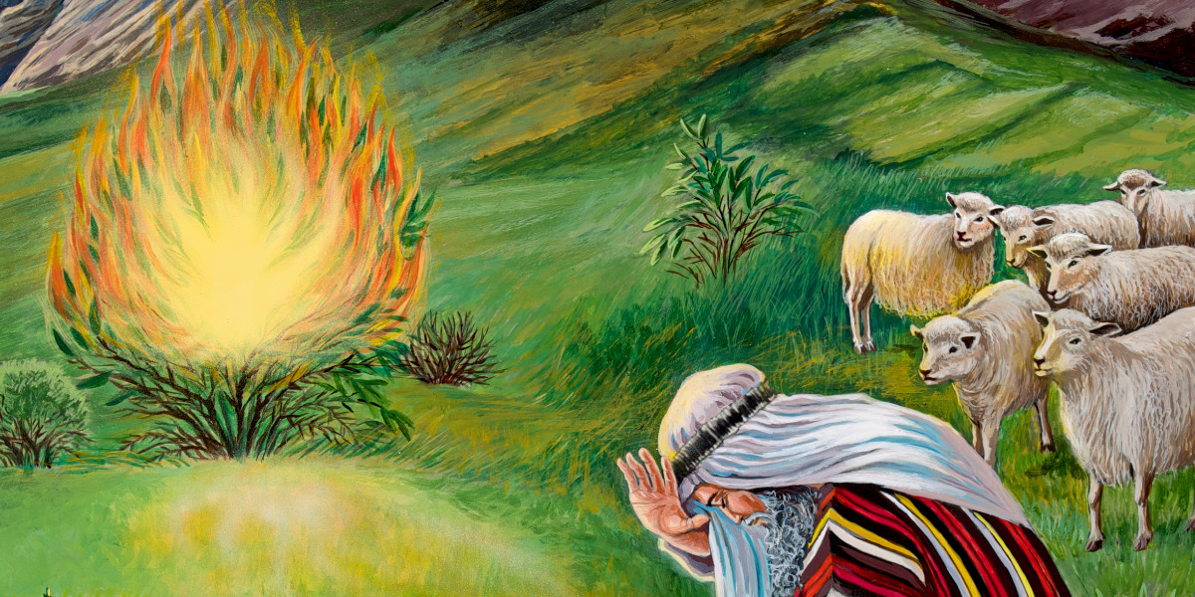
GOD WORKING THROUGH HUMANITY: EXODUS 3:1–15 AND THE THEOLOGY OF DIVINE-HUMAN PATERNERSHIPS by Hermann Finch SCJC , April 2023 Asbury Theological Seminary

Slide 2
Why did God choose Moses to help God lead the Israelites out of Egypt?

Slide 3
Moses was chosen by God due to his:
Upbringing: Moses, God’s mediator in this story of deliverance, has already been born, reared as an Egypto-Hebrew, fled criminal prosecution, and married a Midianite (Exodus 2) when the decisive event occurs.
2. Passion for Justice : Moses’ developing passion for justice thus places him in a place of learning more of the real justice of God.
3. Role as a shepherd: Several commentors point out that shepherding is an idealized Old Testament image for becoming a leader. Moses tended sheep owned by another person; later he would become the leader of a people belonging to God.

Slide 4
Theology of Partnership in Exodus 3:1-15
Many scholars suggest that there is an apparent doublet in verses 7–8 and 9–10. This doublet is appropriate theologically in supporting that neither God (v.8) nor Moses (v.10) acts alone in bringing Israel out of Egypt. They both work together in partnership.
DRIVE
DISCIPLINE
in line with my argument for the paper)
3. representative of Jesus
1. God in human form
2. Jesus

Slide 5
Key Hebrew Verbs
1st Verb: In Exodus 3 verse 8, God comes down, יָרַד, to save his people. God’s presence among God’s people, an act that is revelatory both of his immanence and, ironically, of his glory, is usually expressed by יָרַד in the Qal verb form. This verbal form is also employed in Gen11:5 on the tower of Babel story and Numbers 11:25 when God ‘came down in the cloud’ to speak to Moses and to put his Spirit upon the 70 elders.
2nd Verb: In Exodus 3 verse 10 God sends Moses, שָׁלַח, to bring the Israelites out of Egypt. “The basic syntax of the Qal form of this verb, שָׁלַח, is transitive, where A sends B. Generally, A denotes a person (human or divine), while B can be another person such as a servant, or B can also be an inanimate object such as a gift, help, or a message.

Slide 6
Conclusion
The story of Moses and his call to work with God to set the Israelites free from Egyptian bondage is one that portrays how God is present with God’s people and how God cares for their liberation. This account has shown that God uses one’s upbringing, passions, and vocation to be an instrument of advancing God’s kingdom. God is still working today and wants to use these aspects of our lives and experiences to serve others.

Slide 7
Thank You!

